Slide 2
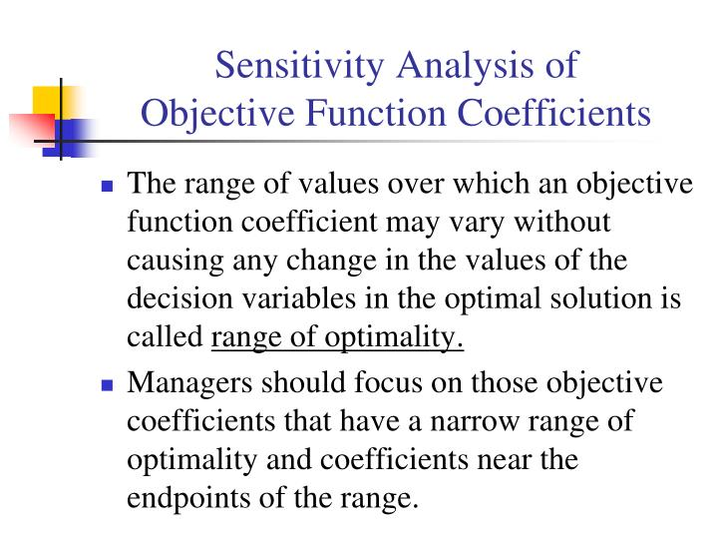

Slide 3
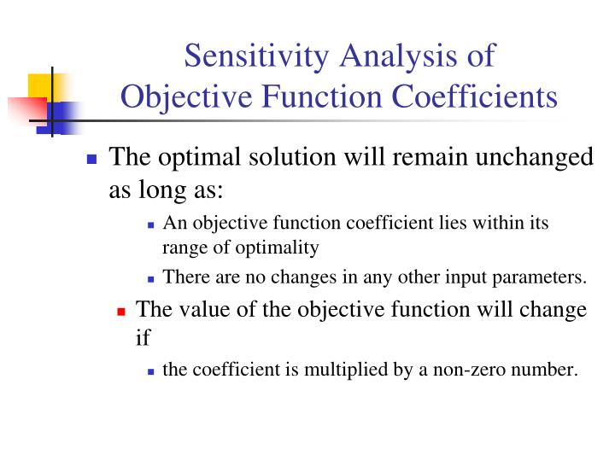

Slide 4
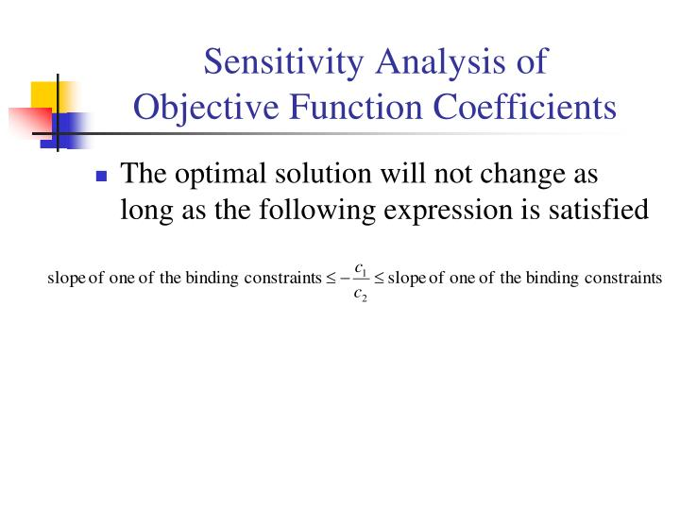

Slide 5
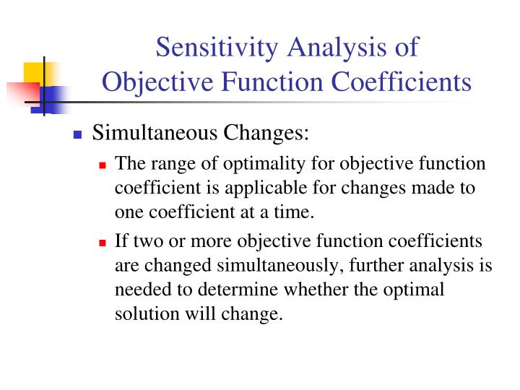

Slide 6
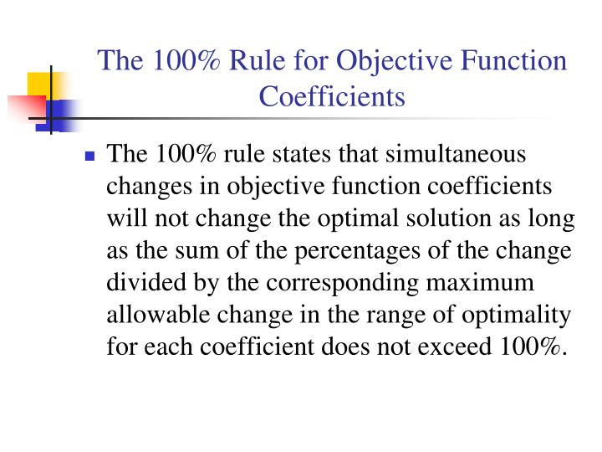

Slide 7
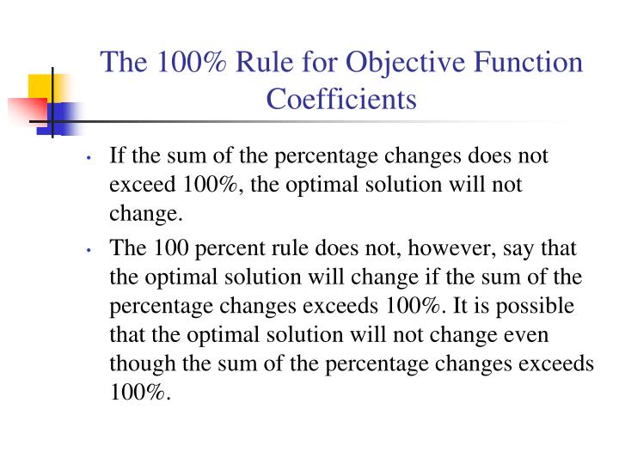

Slide 8
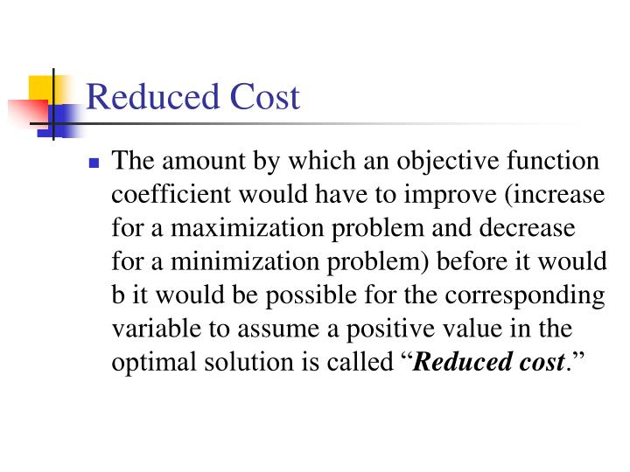

Slide 9
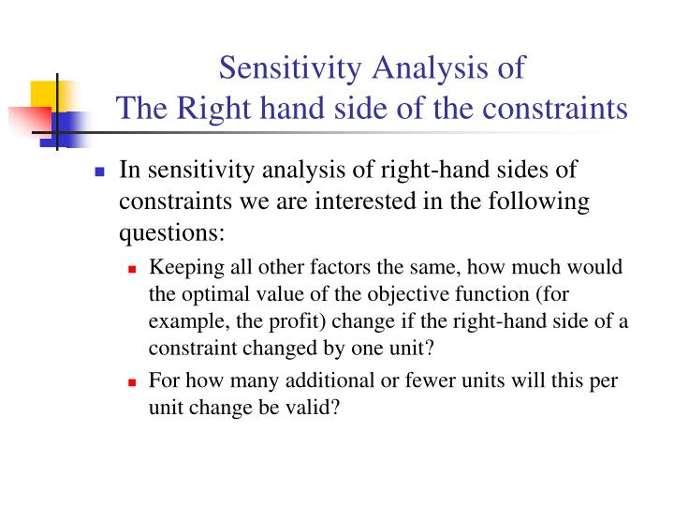

Slide 10
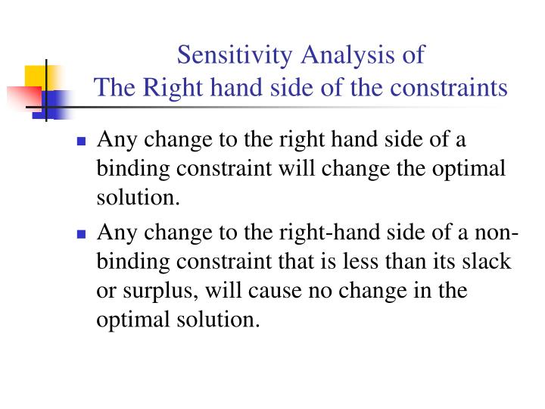

Slide 11
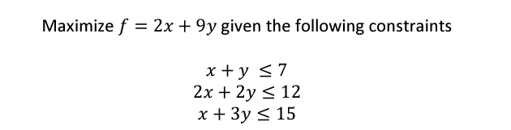
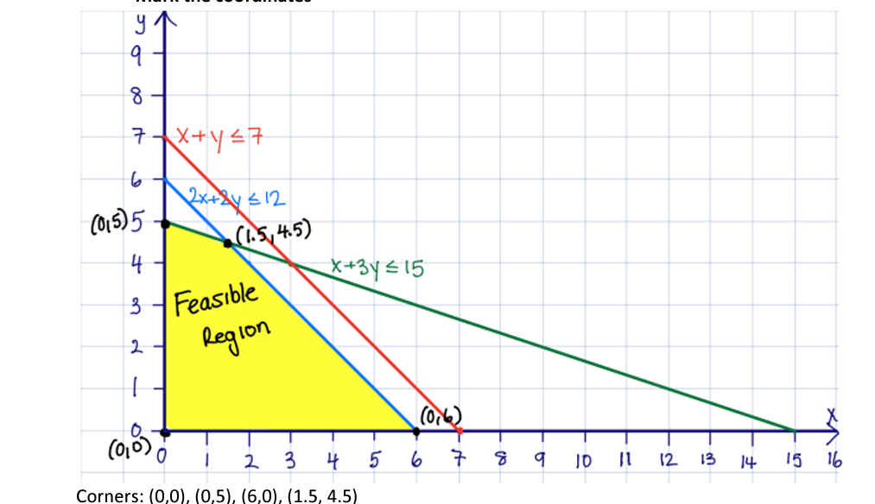

Slide 12
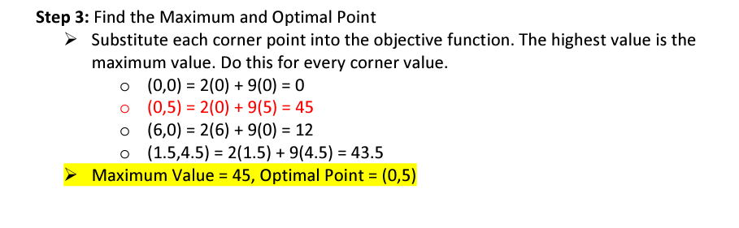

Slide 13
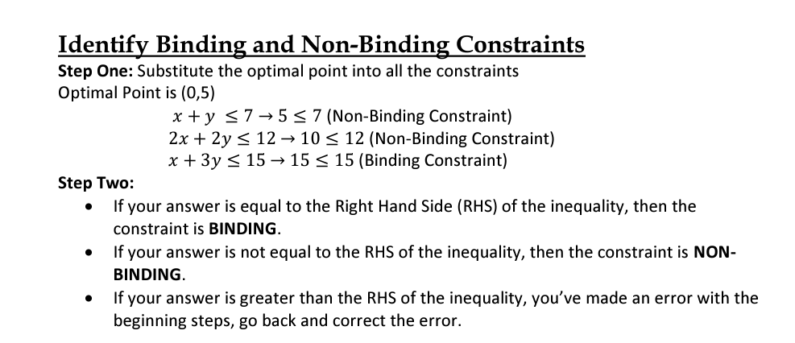
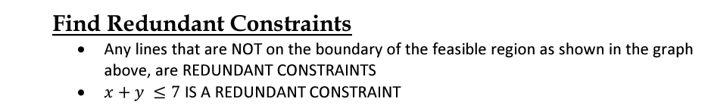

Slide 14
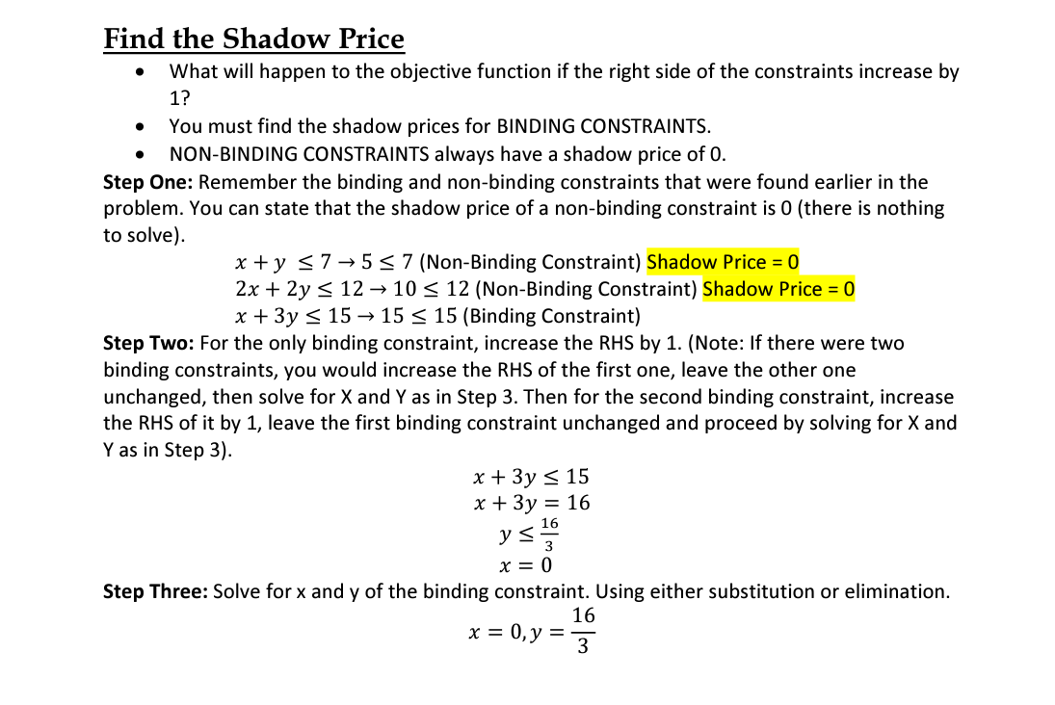

Slide 15
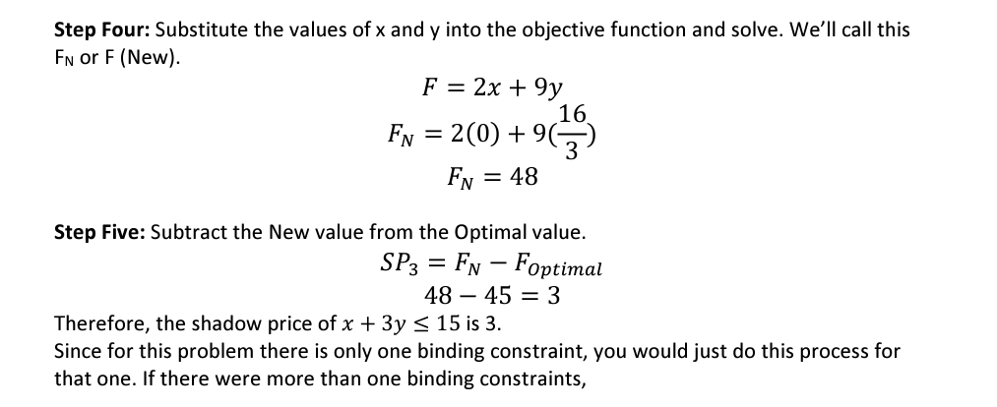

Slide 16
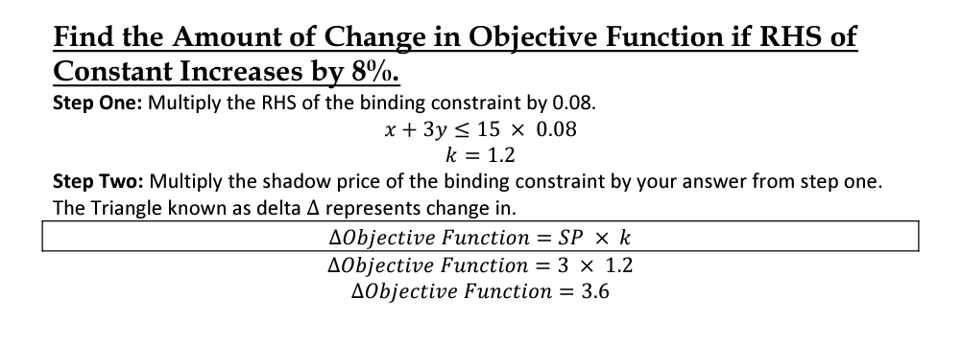

Slide 17
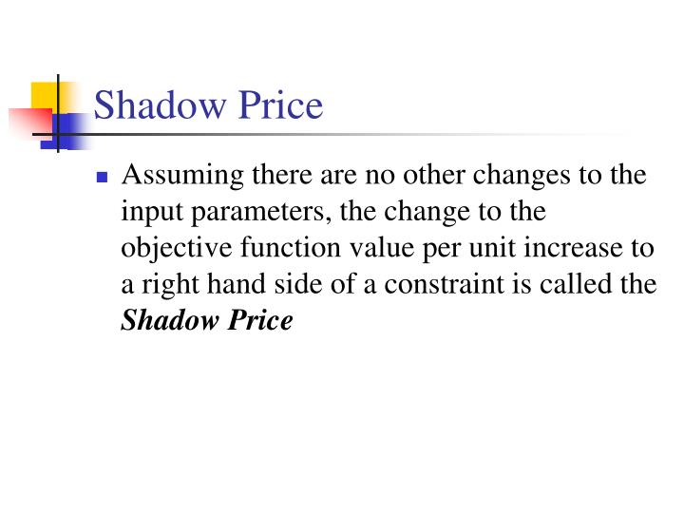

Slide 18
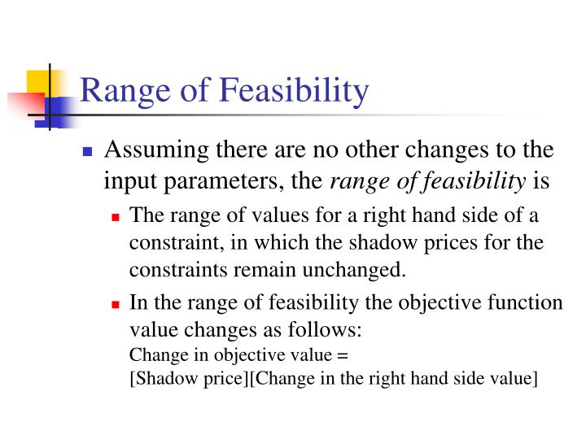

Slide 19
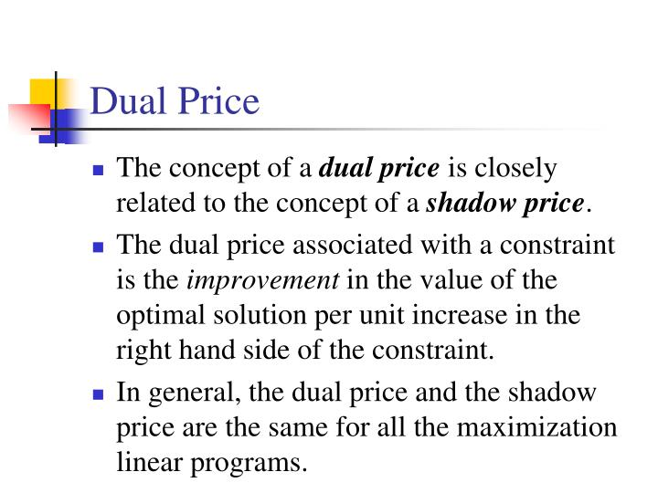

Slide 20
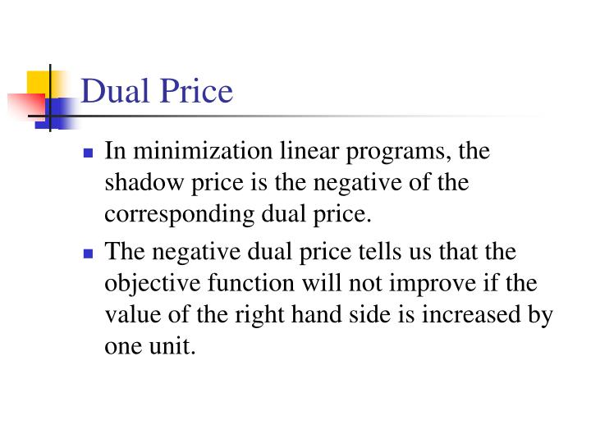

Slide 21
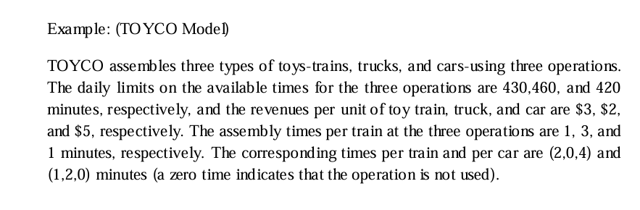
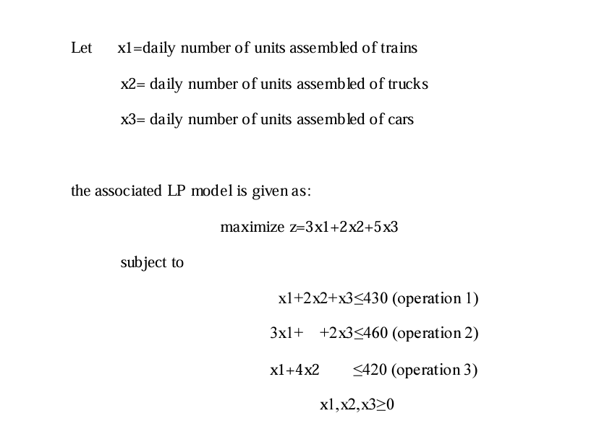

Slide 22
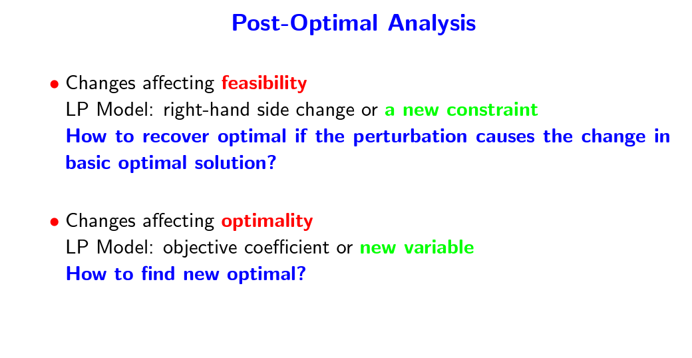

Slide 23
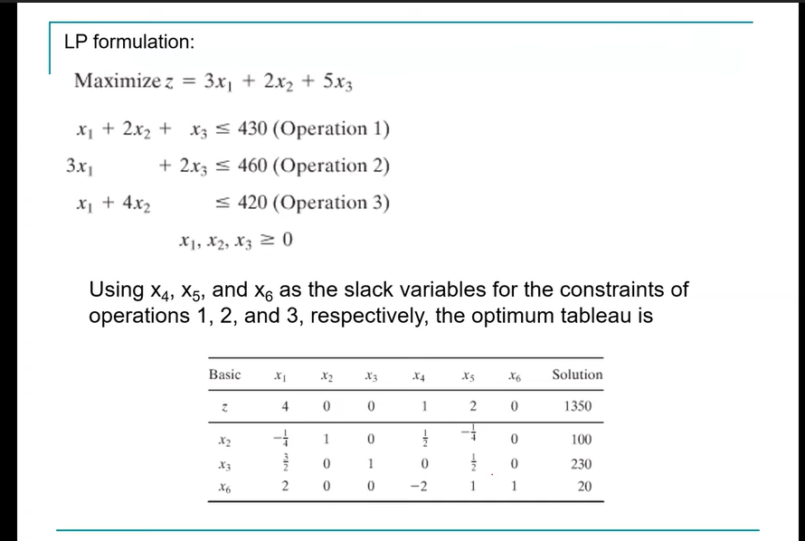

Slide 24
Current optimal: z=1350 x1=0, x2=100, x3=230

Slide 25
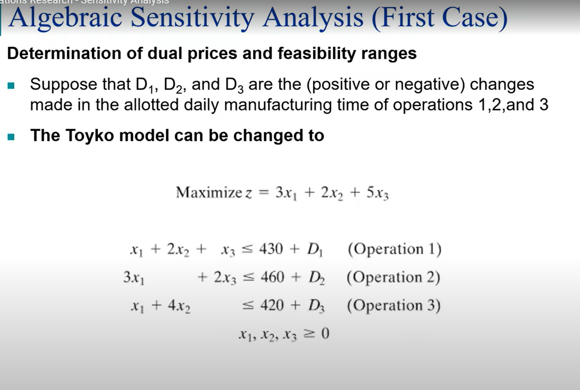

Slide 26
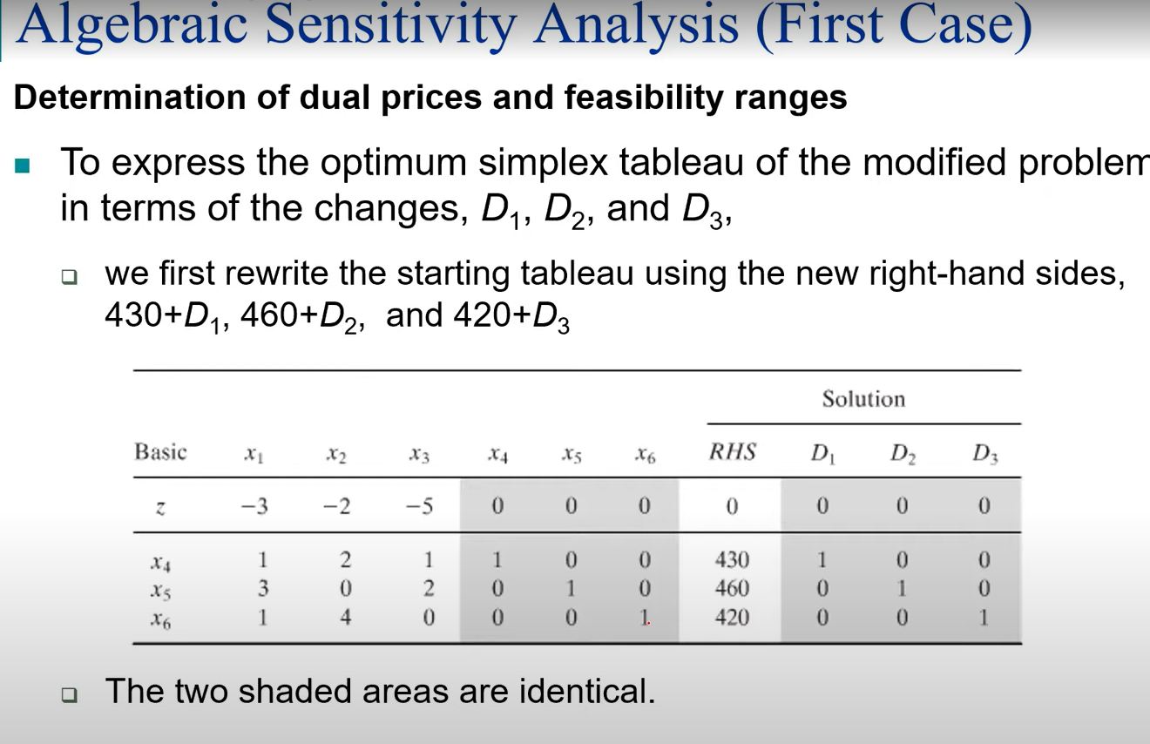

Slide 27
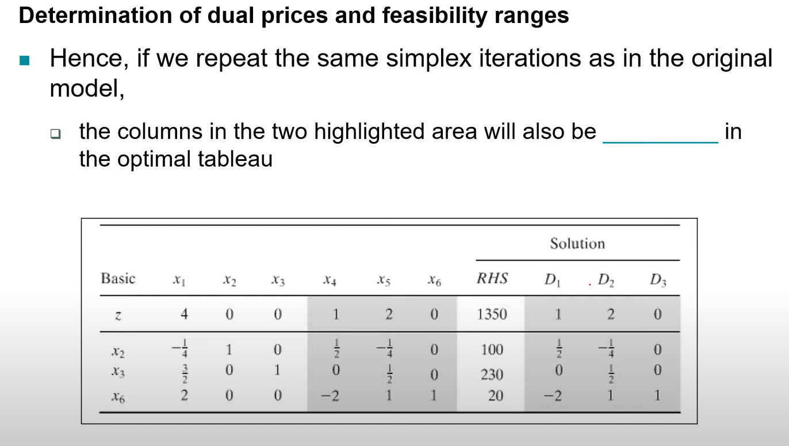

Slide 28
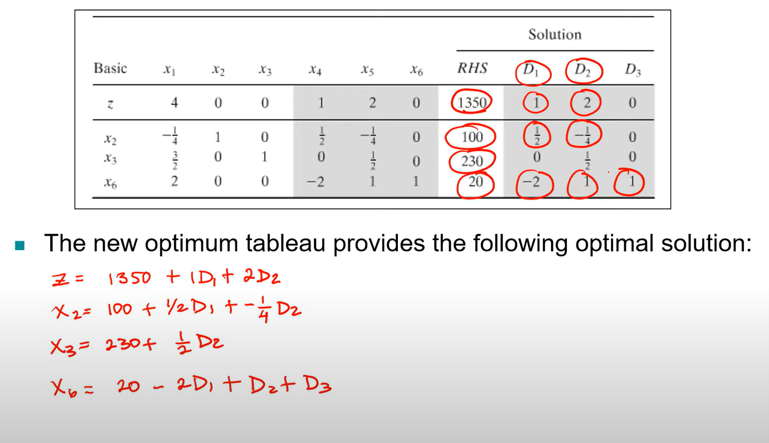

Slide 29
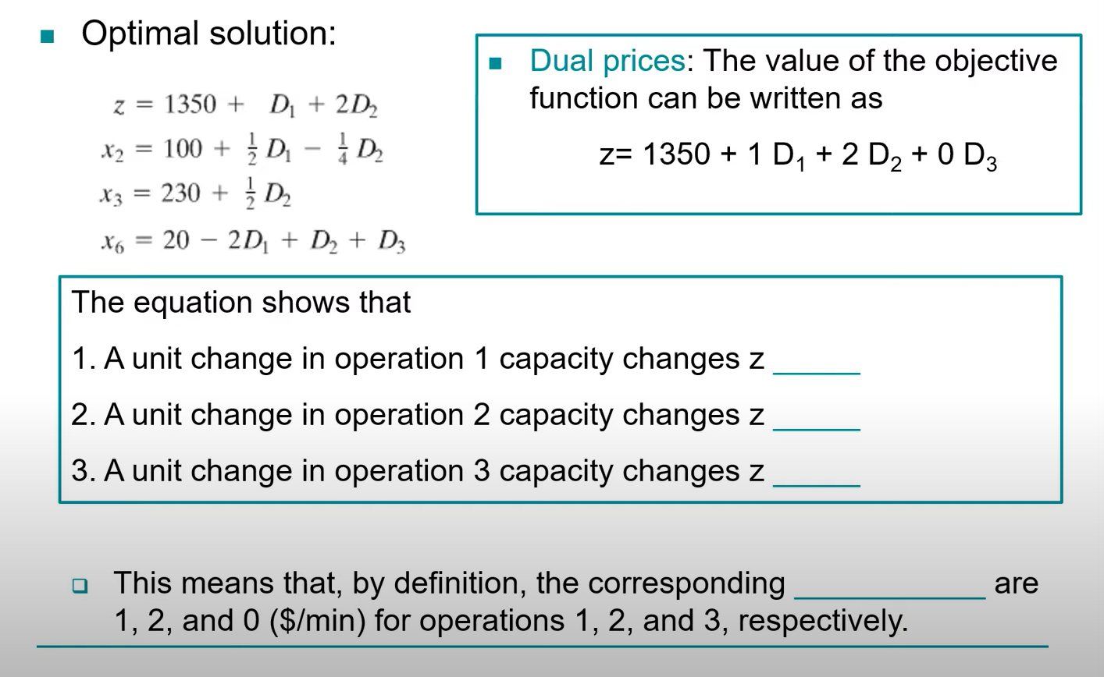

Slide 30
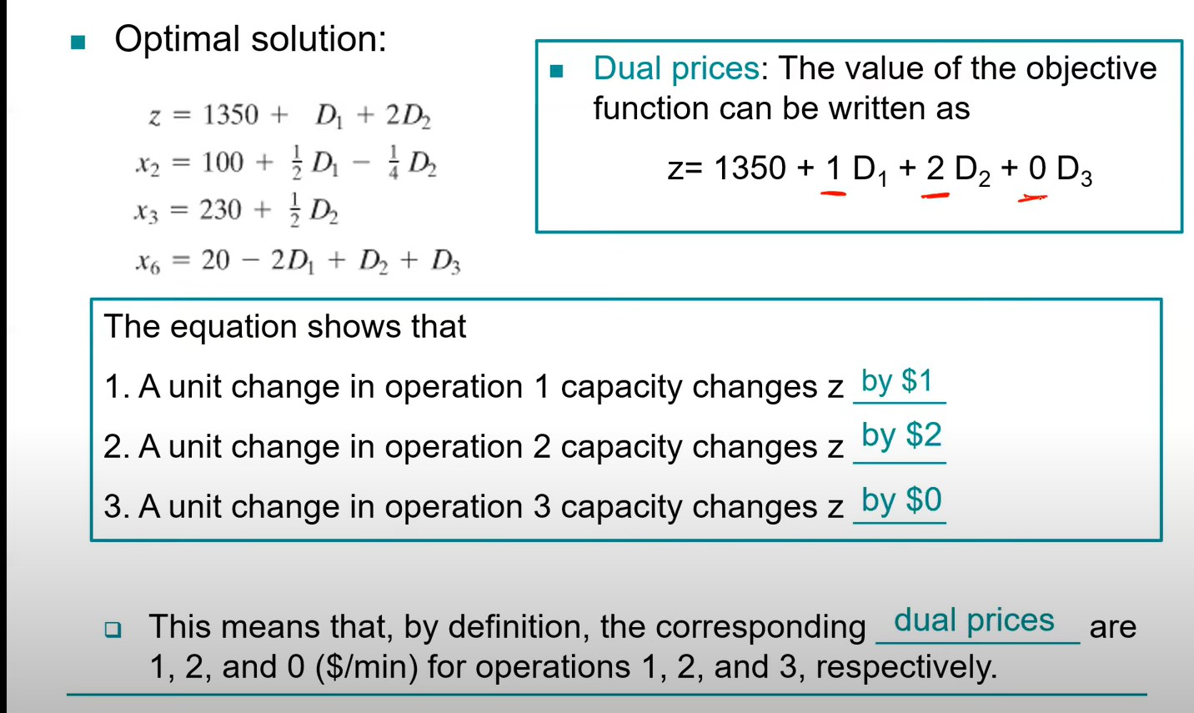

Slide 31
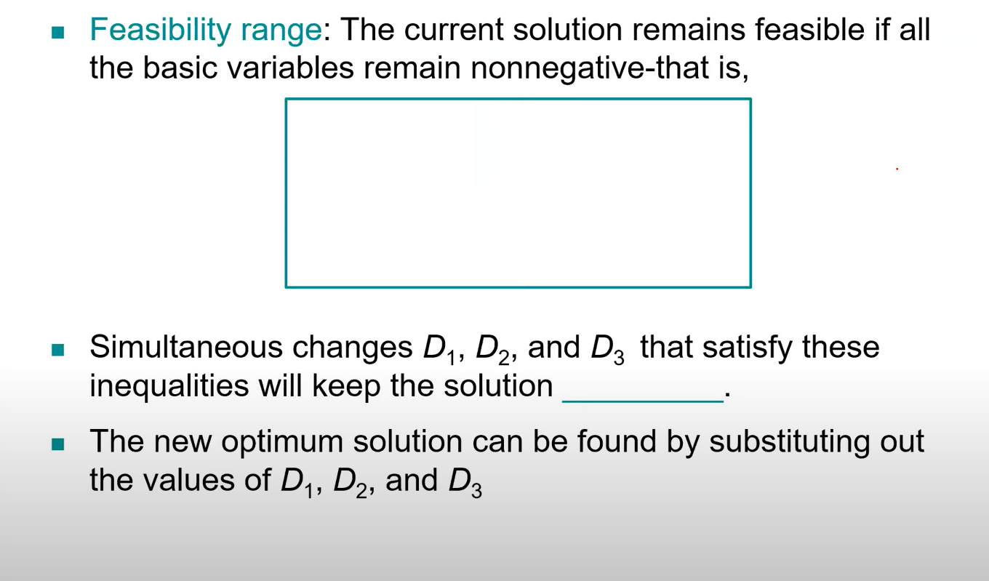

Slide 32
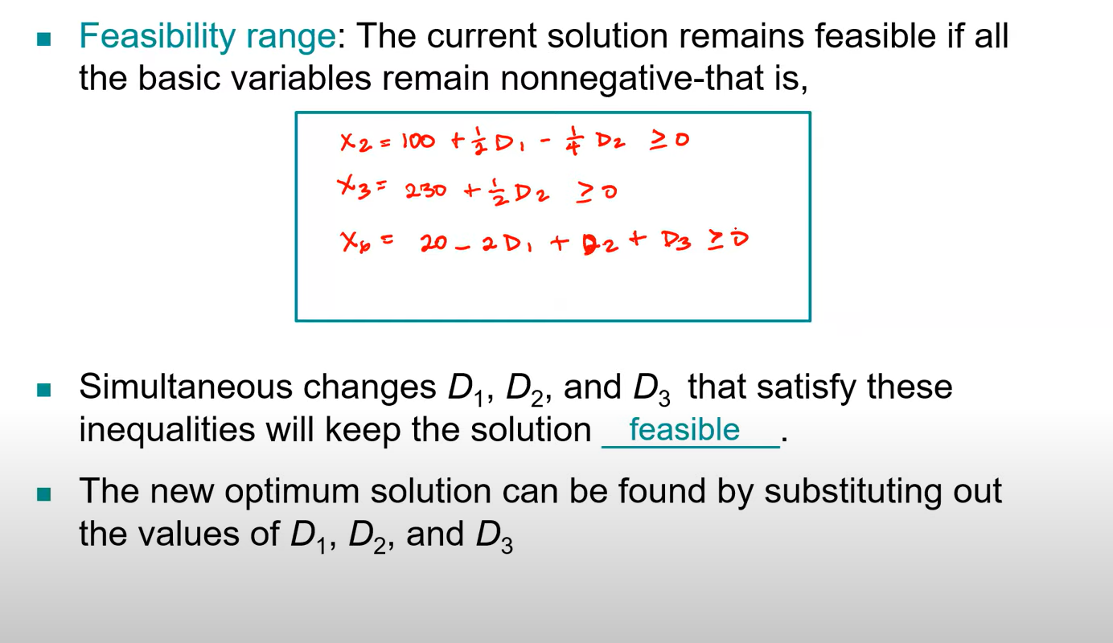

Slide 33
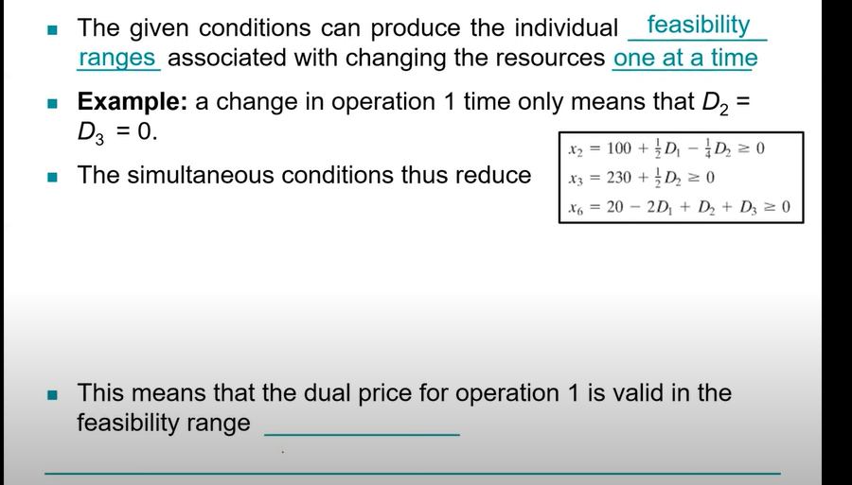

Slide 34
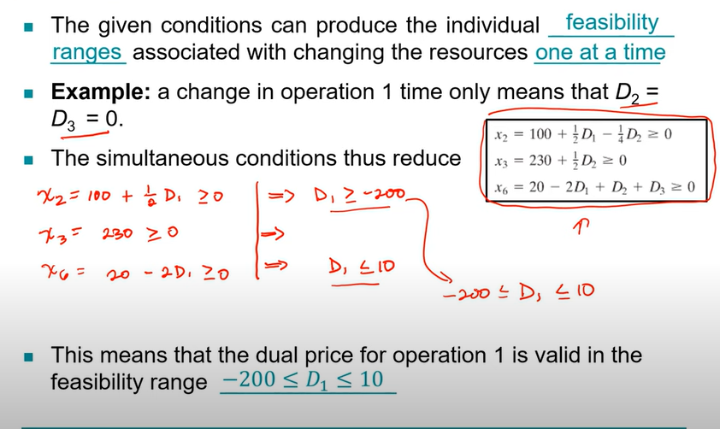

Slide 35
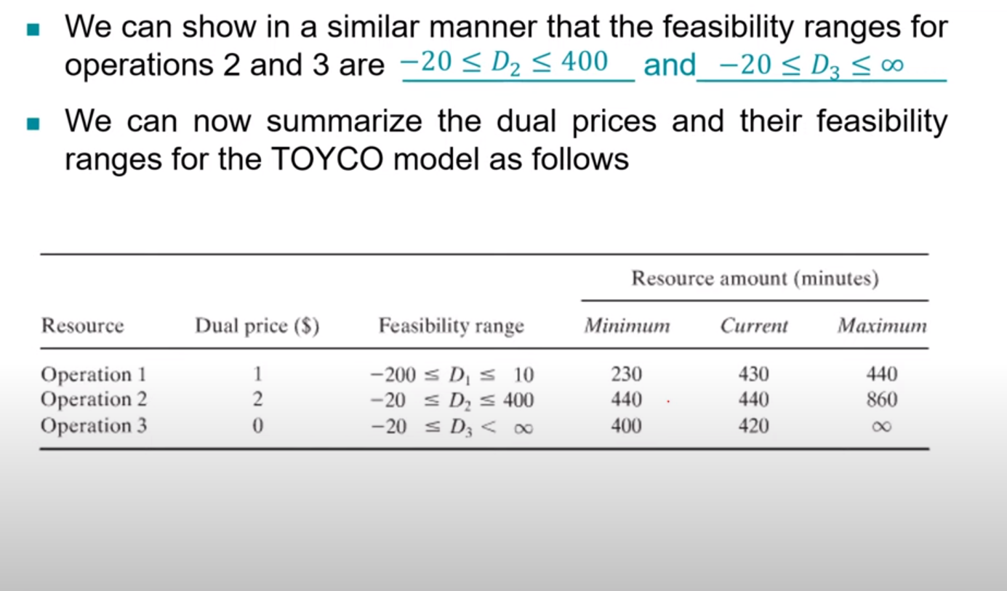
Error: read 440 in current slide as 460

Slide 36
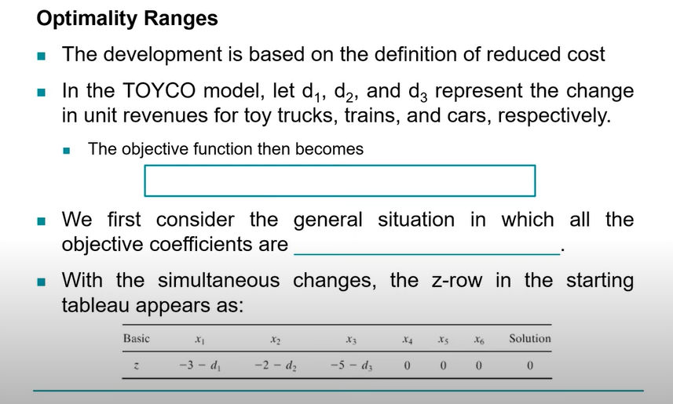

Slide 37
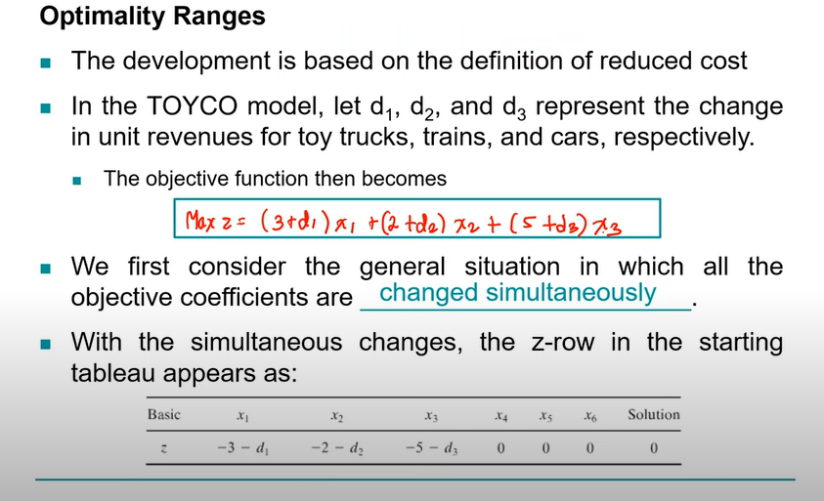

Slide 38
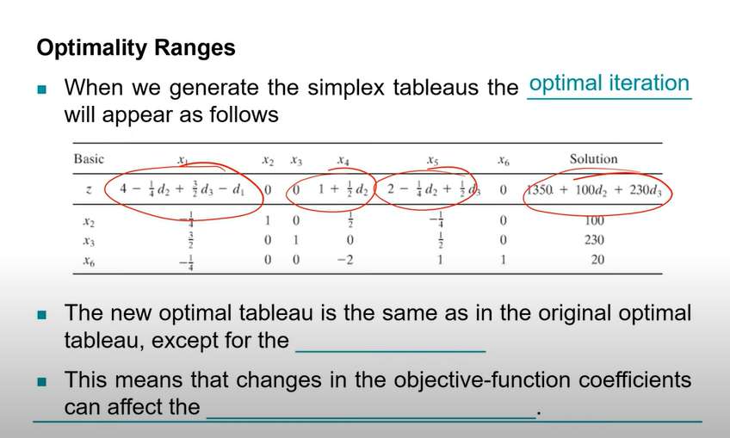

Slide 39
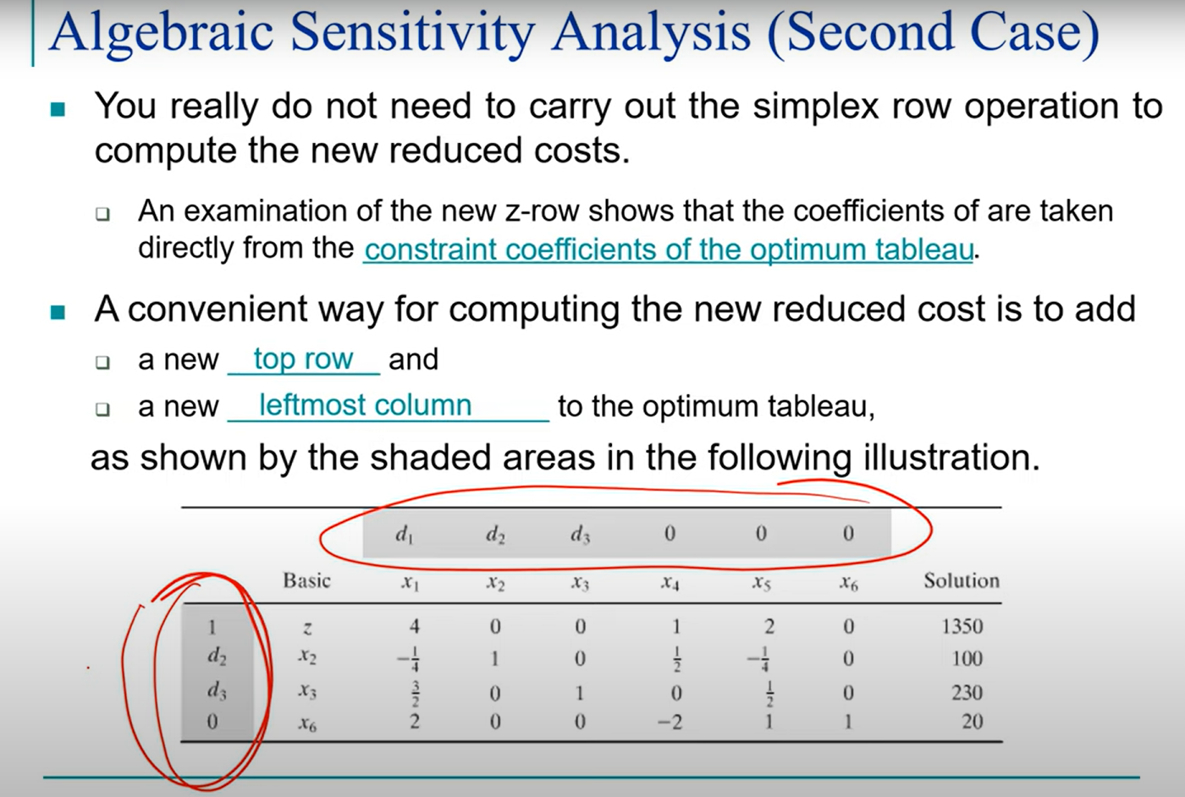

Slide 40
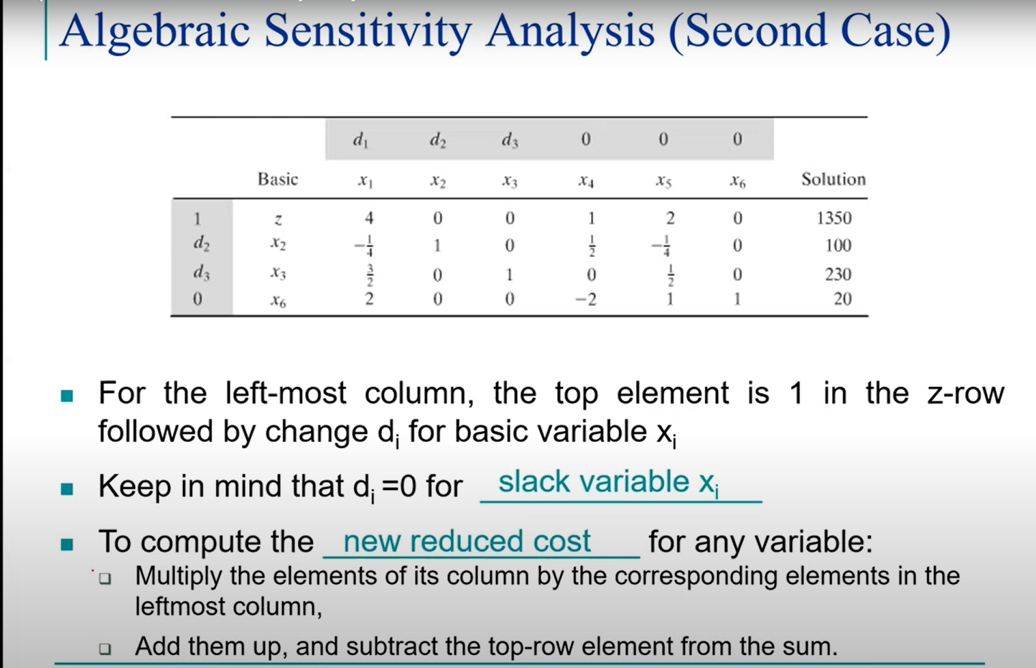

Slide 41
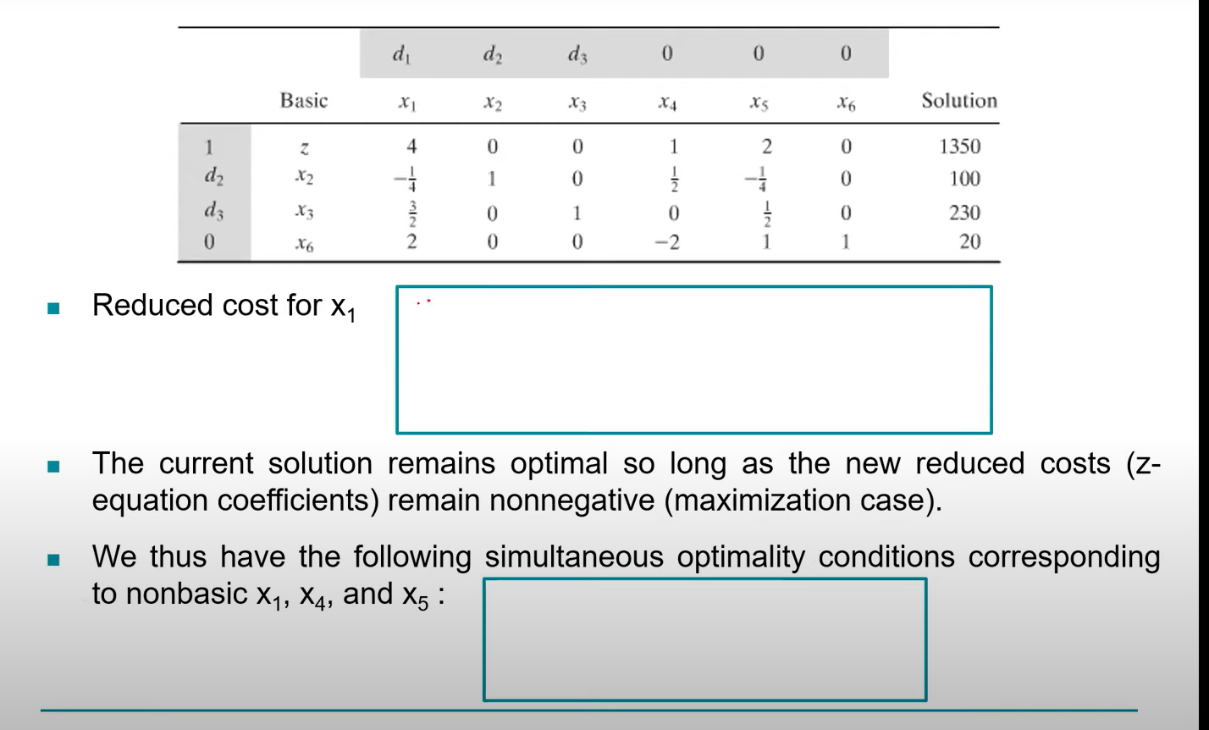

Slide 42
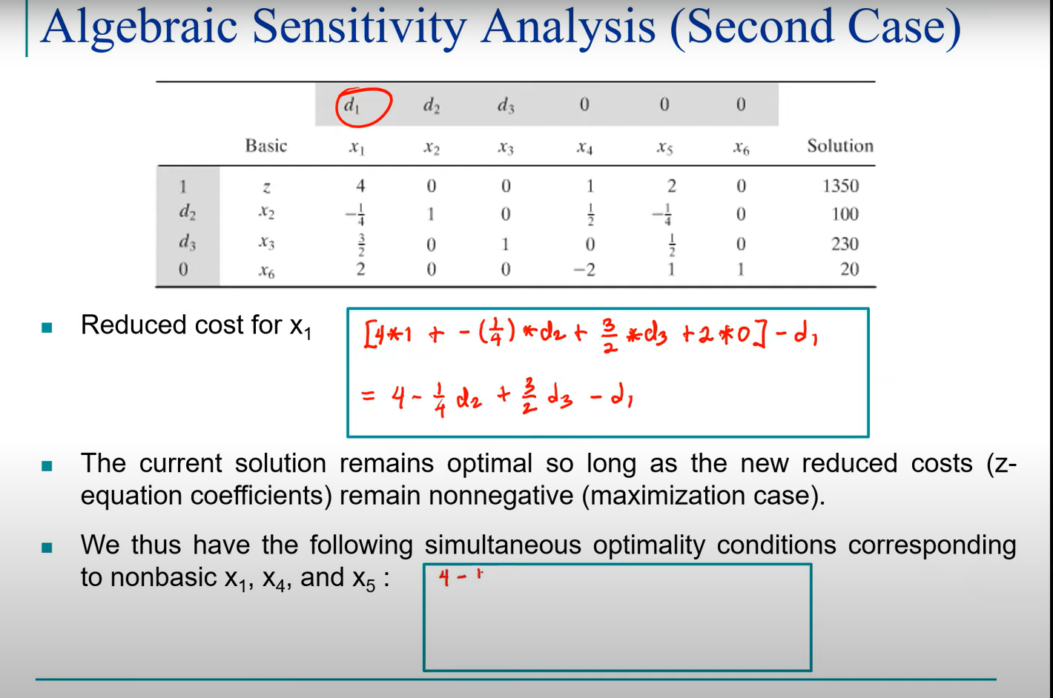

Slide 43
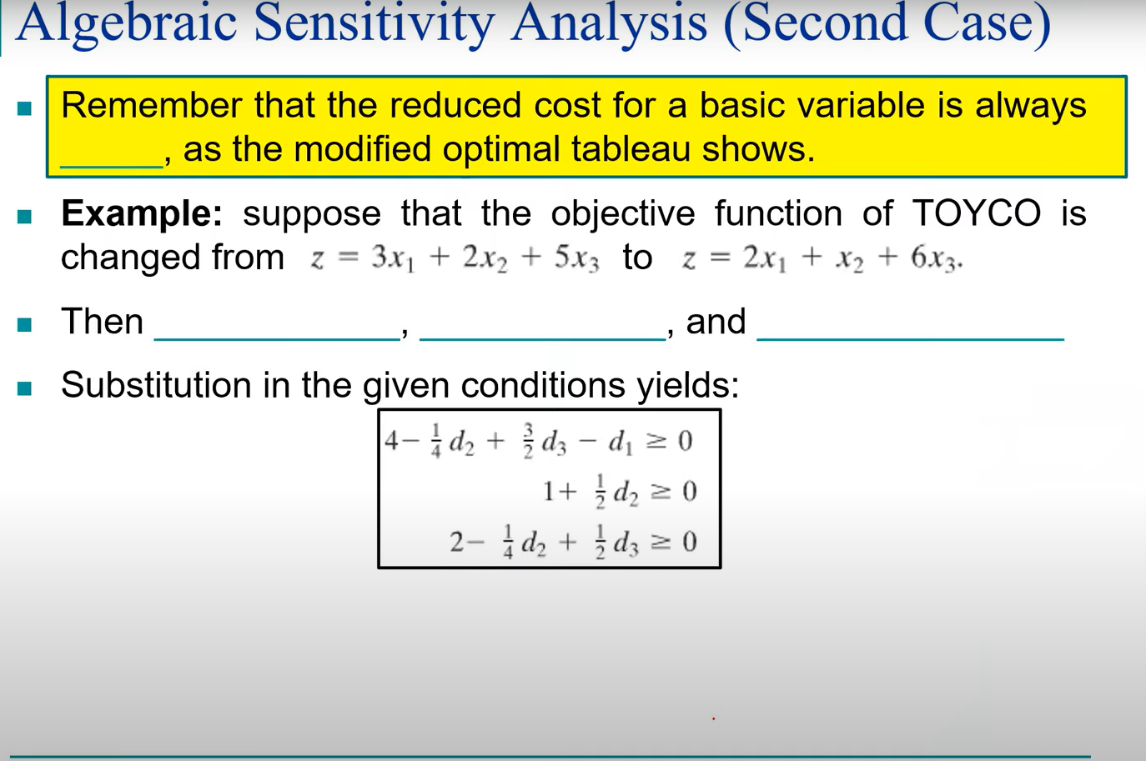

Slide 44
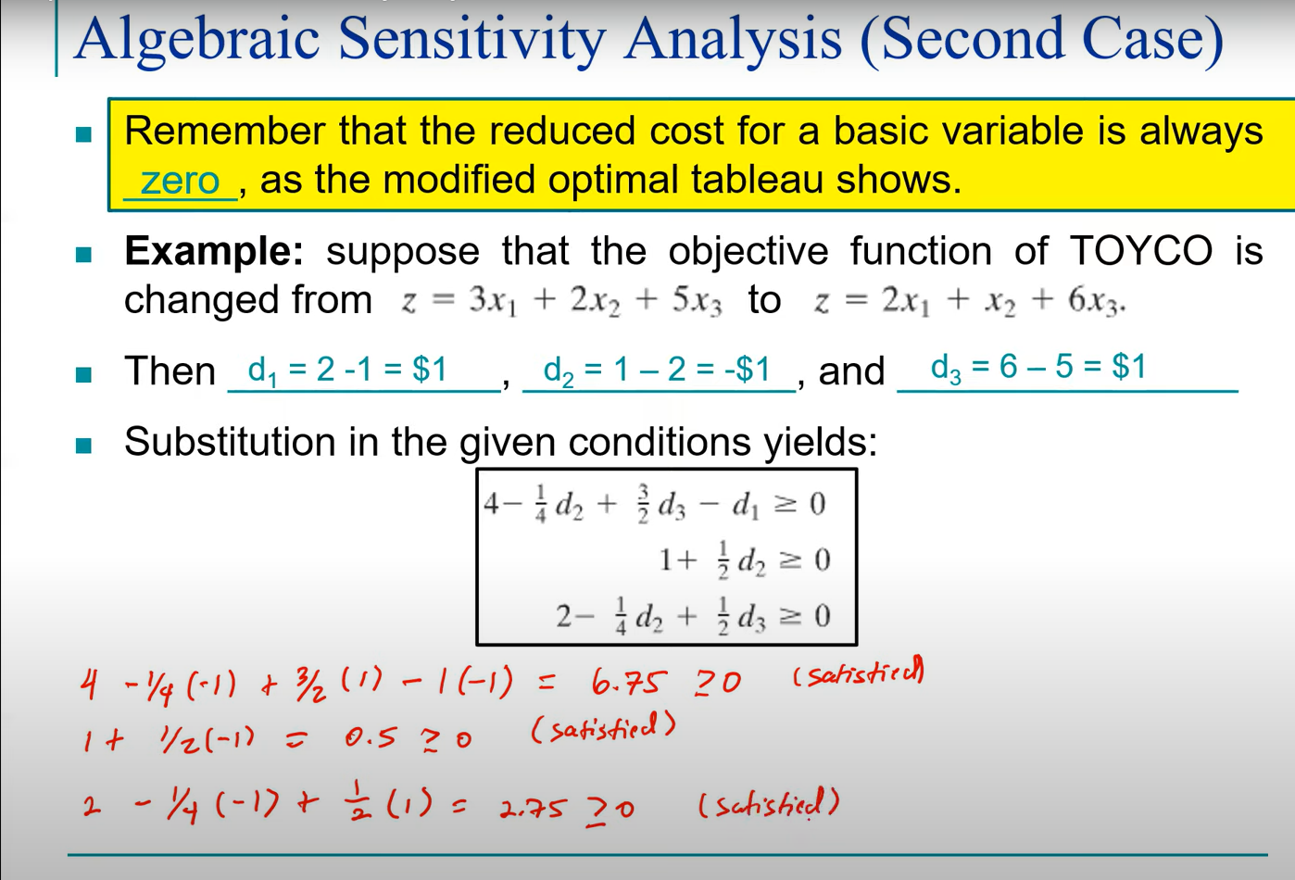

Slide 45
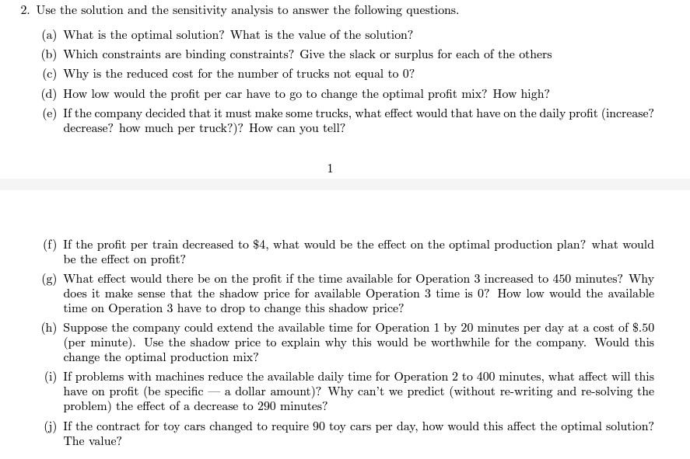
HW DUE Next Week

Slide 46
HW Due 7th Feb 2024
Work as a team, not more than 3 MEMBERS in each group
Please make a google drive submit all assignments in the drive
Name of the file contains
Name of members
MND 500
HW 1

Slide 47
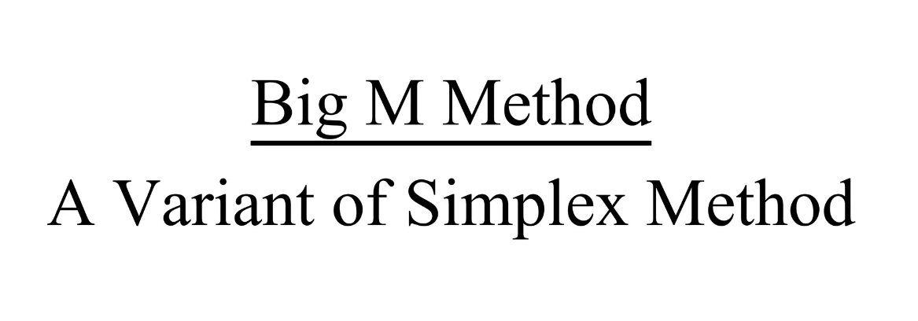

Slide 48
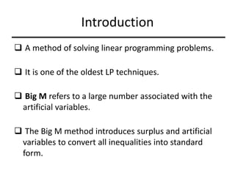

Slide 49
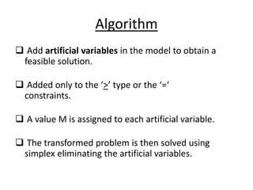

Slide 50
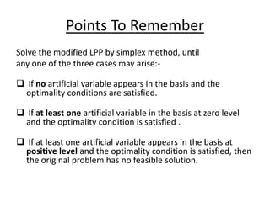

Slide 51


Slide 52


Slide 53


Slide 54


Slide 55


Slide 56
The variable s1 appears only in the first constraint and has a coefficient of 1, so it can be the basic variable for the first constraint. Although s2 appears only in the second constraint, it has a coefficient of 1; therefore, there is no variable in the second constraint that can act as a basis variable (multiplying the second constraint by 1 makes the right-hand-side coefficient negative). The third constraint also has no unique variable ready to be basic. In this case we create a basic but infeasible solution by adding two new nonnegative variables, A2 A3, to the left-hand side for the second and third constraints. These are called artificial variables. (We use the notation Ai where it is added to the ith constraint.) This gives the new form of the problem, which is in canonical form.

Slide 57


Slide 58


Slide 59


Slide 60


Slide 61


Slide 62


Slide 63


Slide 64

Since each artificial variable will be in the starting basis, all artificial variables must be eliminated from row 0 before beginning the simplex.

Slide 65


